Slide 1
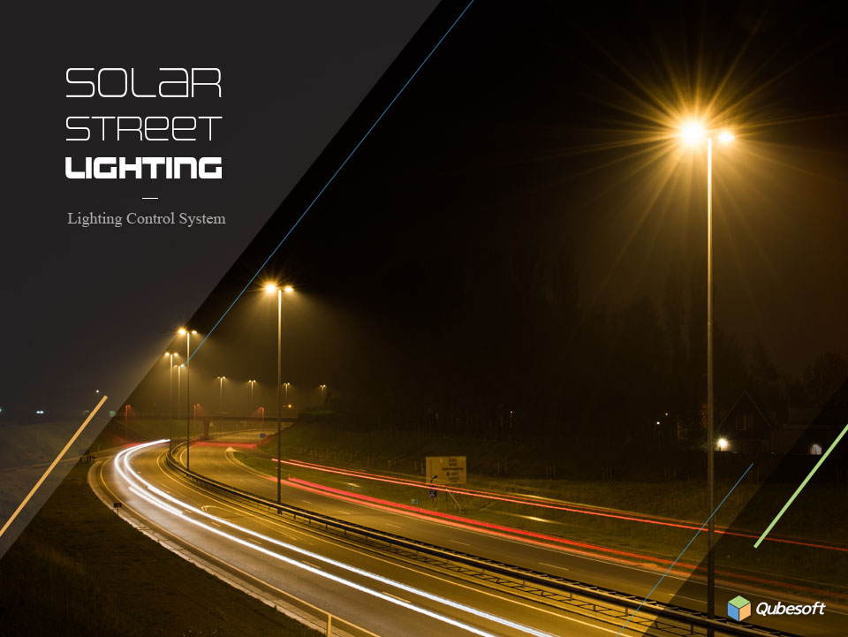

Slide 2
CONTENTS
System summary
System configuration
Device Specifications
Screenshots
Dashboard
Monitoring
Controls
Statistical Analysis
Settings
Mobile

Slide 3




1. System Summary
Wireless street light control system will provide efficient management of the equipment because it does not require any cabling connection and onsite service. This solution enable remote dimming/ON-OFF control using GSM and ZIGBEE wireless technology. This can significantly reduce the cost and time spent on operations and maintenance in your facilities.
Monitoring
Control
• Alarm monitoring
(Lamp ON/OFF, Battery info, Alarm status,
communication status)
• Total dashboard monitoring
(Intuitive interface)
• Web-based total monitoring system
• Remote control of road lighting by
individual, group permission
• Remote control by map search
• ON/OF, dimming control by time setting
• Remote control by mobile phone
Statistical Analysis
Management
• Statistical analysis of error conditions
by table and chart
• Daily and monthly chart for errors
(Print, Saving as PDF/EXCEL file)
• System access permission, group settings
• User’s access history
• Management of RTU devices
• System settings

Slide 4







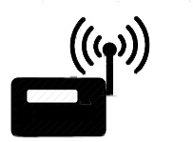


2. System configuration
Management
Internet
App Server
Internet
GSM network
Gateway
Remote control
Group #1
.
.
.
GSM Modem
RTU Router
Wireless RTU
Wireless RTU
. . . N
Group #N
Solar Lighting
Solar Lighting
Solar Lighting

Slide 5
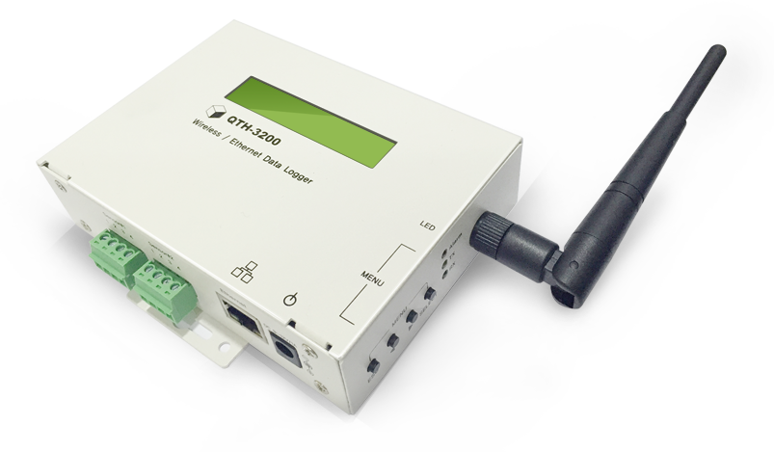
3. Device Specifications
RTU Router / Wireless RTU
Product applications : Data transmission to
Web monitoring server
Size: 125mm (Width) × 90mm (Vertical) × 33 (Thickness) mm
Display: 2 Lines CLCD
External interface : RS-485 1Port, RS232 1Port,
RJ-45 Ethernet 1Port, Micro USB debugger 1Port
Wireless module: ZIGBEE module
Memory : 2G Micro SD Memory
Operating temperature : 0 - 80 °C
Power : DC IN 6V ~ 9V 1.5A
Manufacturing country : Made in Korea

Slide 6
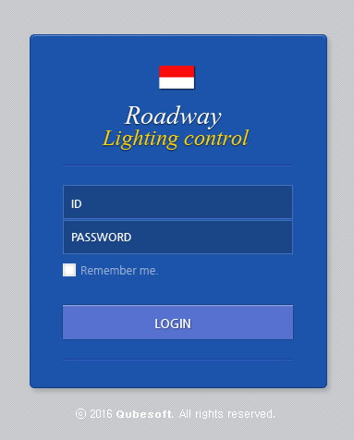
4. Screen shot
1) Main – Login
Wireless street light control system will provide efficient management of the equipment because it does not require

Slide 7
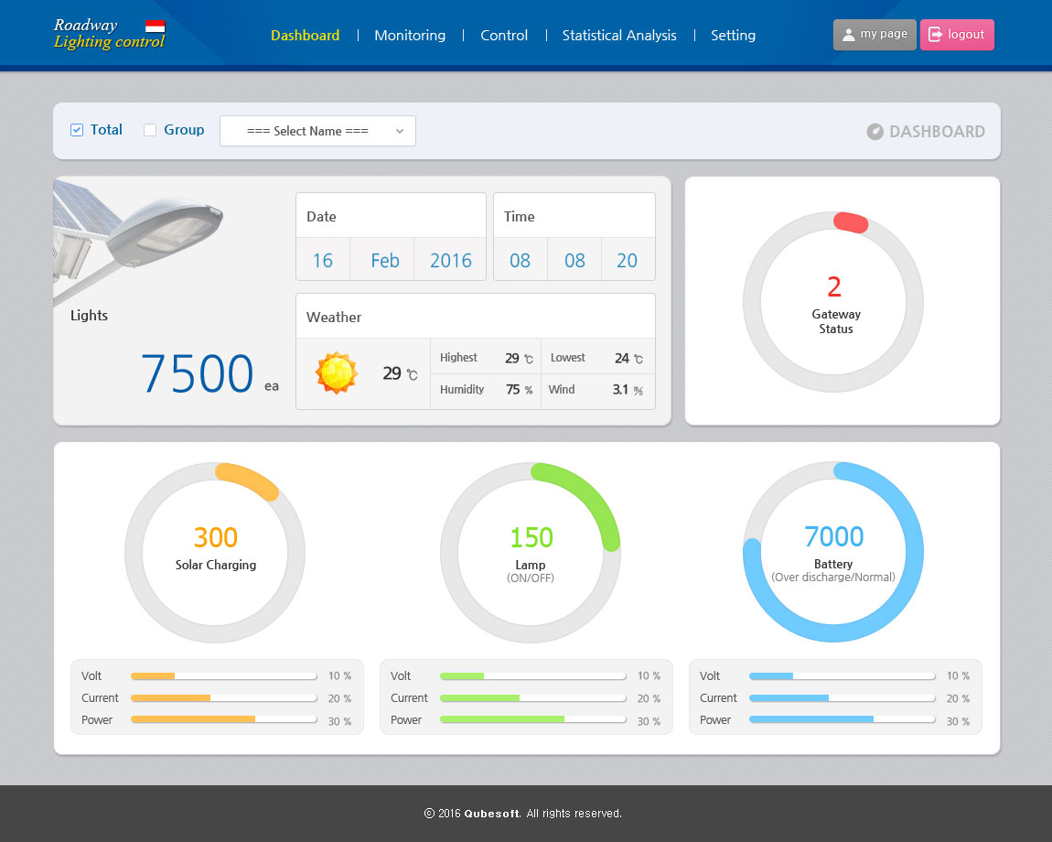
4. Screen shot
2) Dashboard
Wireless street light control system will provide efficient management of
Remote control of road lighting by individual, group permission
Remote control by map search
ON/OF, dimming control by time setting
Remote control by mobile phone

Slide 8
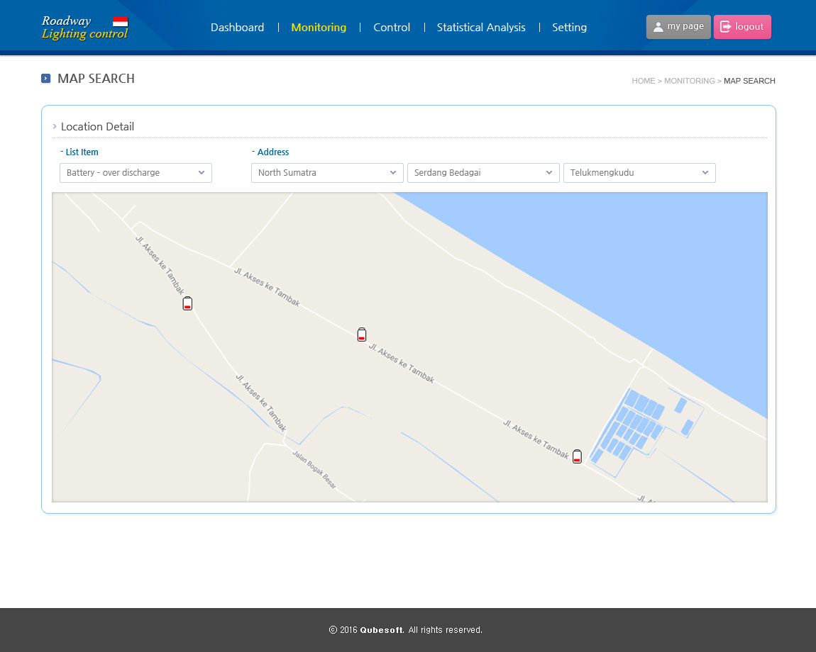
4. Screen shot
3) Monitoring > Map Search > Location Detail
UpdateTemplate
Template
CatCat

Slide 9
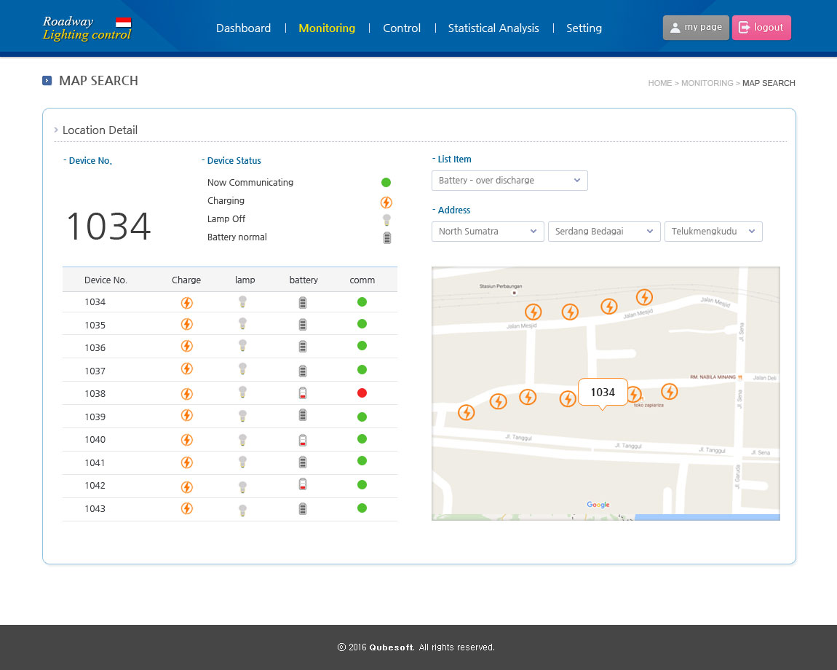
4. Screen shot
3) Monitoring > Map Search > Location Detail
UpdateTemplate
Template
CatCat

Slide 10
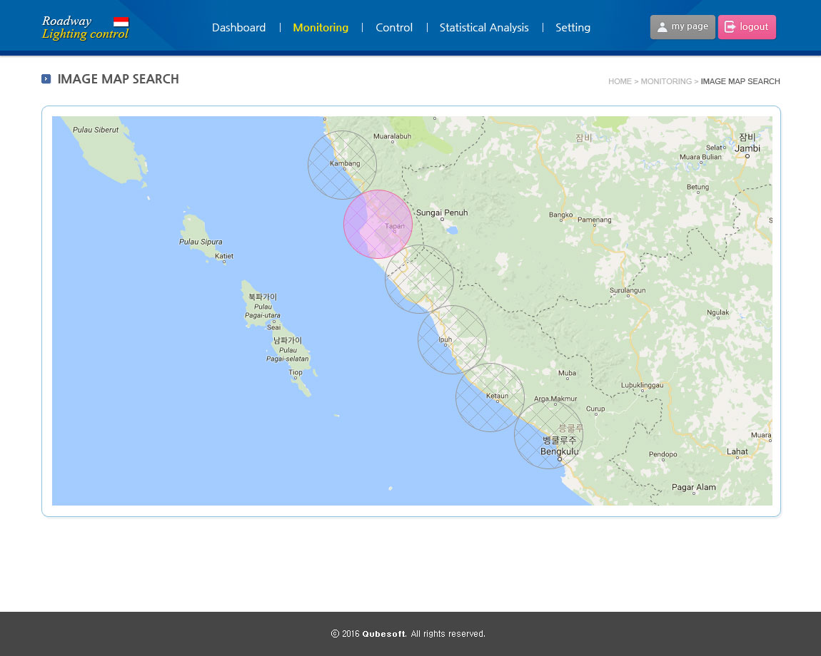
4. Screen shot
3) Monitoring > Image Map Search
UpdateTemplate
Template
CatCat

Slide 11
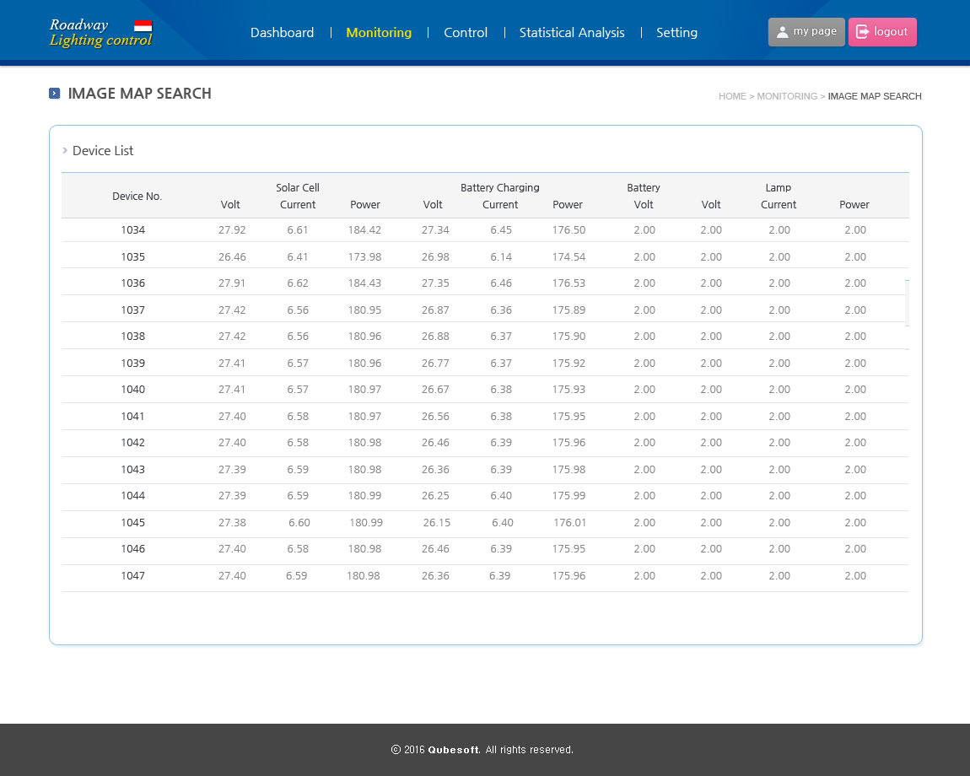
4. Screen shot
3) Monitoring > Image Map Search > Device List
UpdateTemplate
Template
CatCat

Slide 12
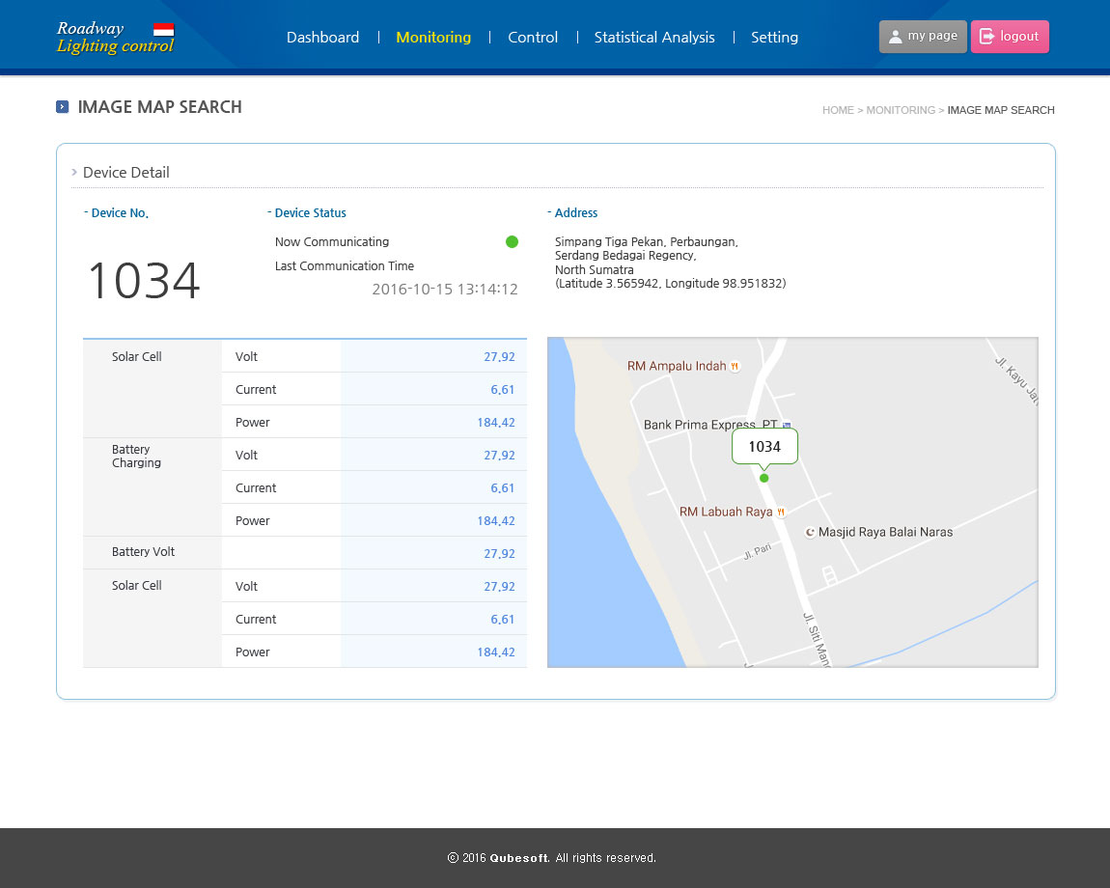
4. Screen shot
3) Monitoring > Image Map Search > Device List > Device Detail
UpdateTemplate
Template
CatCat

Slide 13
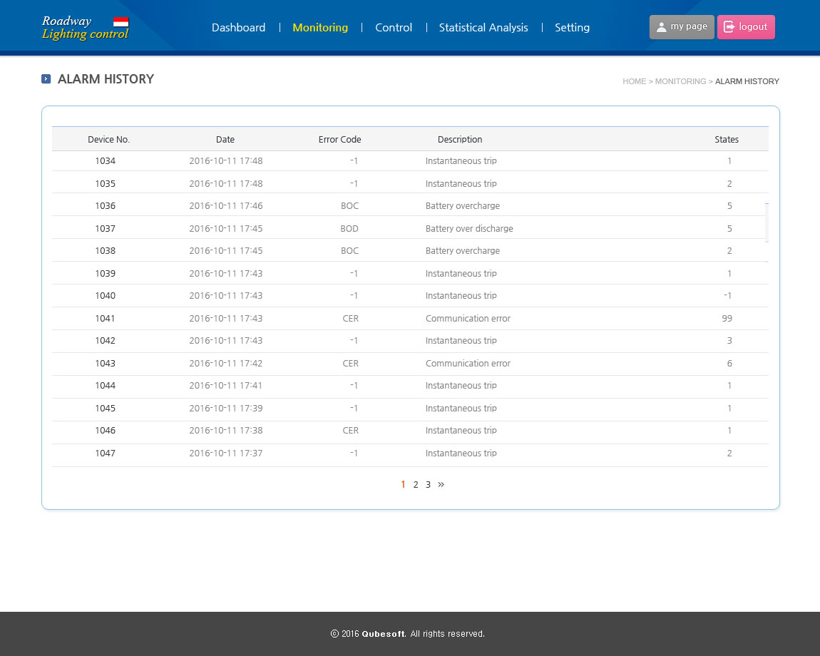
4. Screen shot
3) Monitoring > Alarm History
UpdateTemplate
Template
CatCat

Slide 14
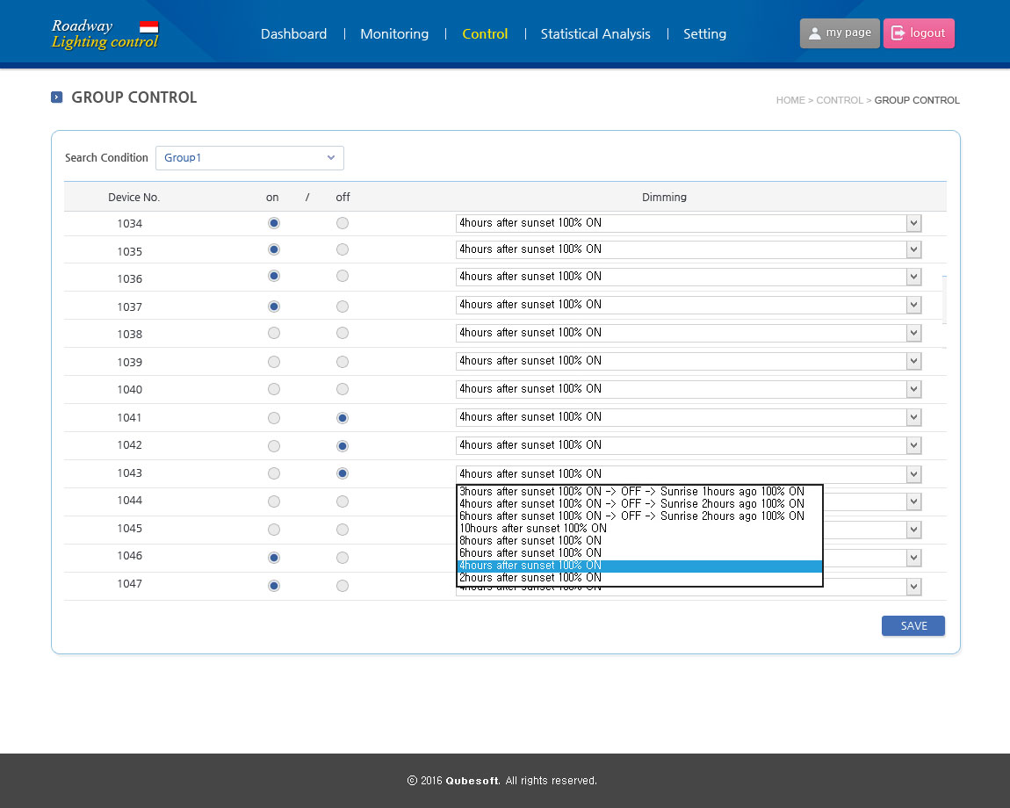
4. Screen shot
4) Control > Group control
UpdateTemplate
Template
CatCat

Slide 15
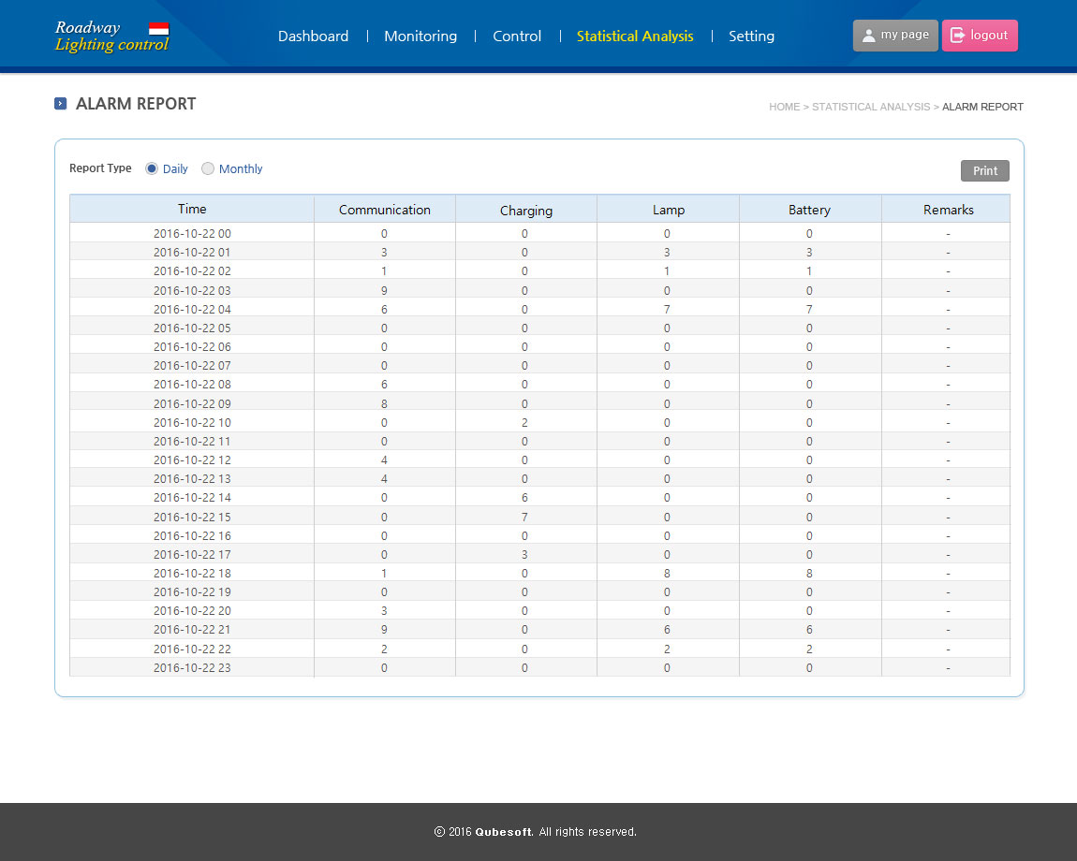
4. Screen shot
5) Statistical Analysis > Alarm reporty
UpdateTemplate
Template
CatCat

Slide 16
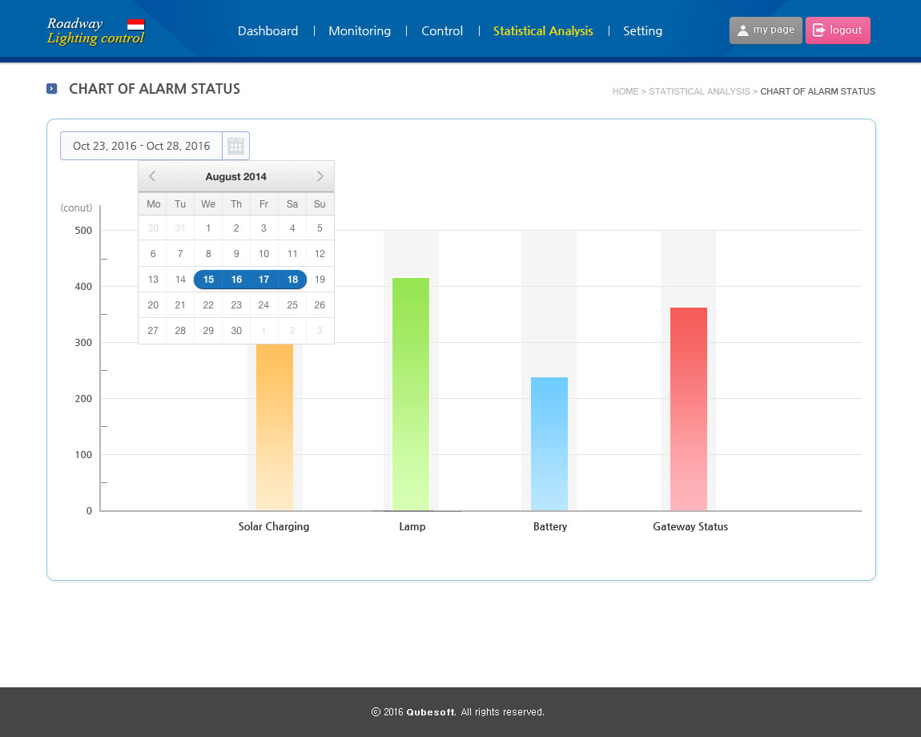
4. Screen shot
5) Statistical Analysis > Chart of Alarm status
UpdateTemplate
Template
CatCat

Slide 17
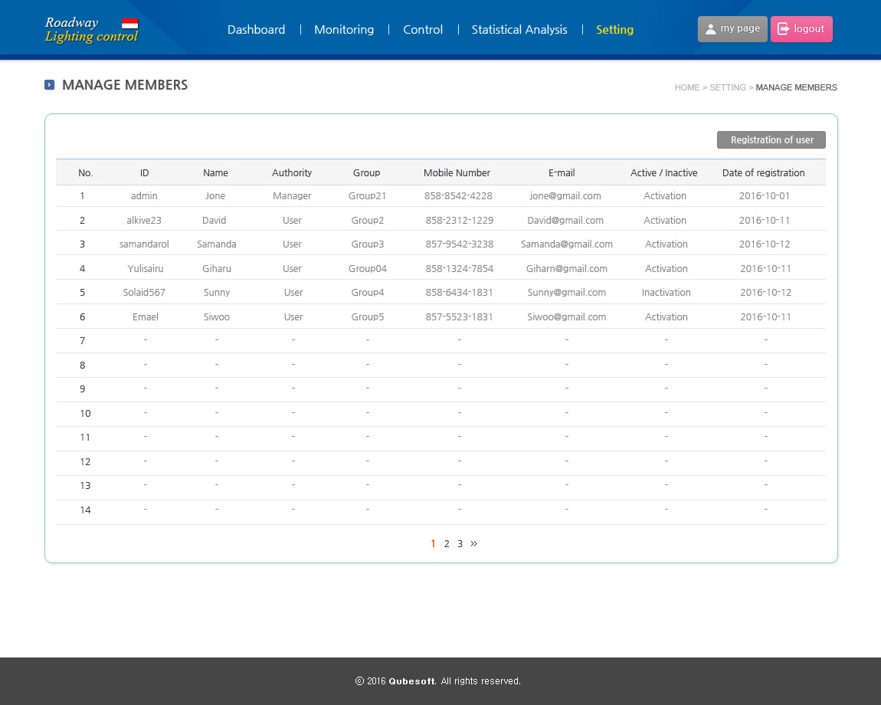
4. Screen shot
6) Settings > Manage members
UpdateTemplate
Template
CatCat

Slide 18
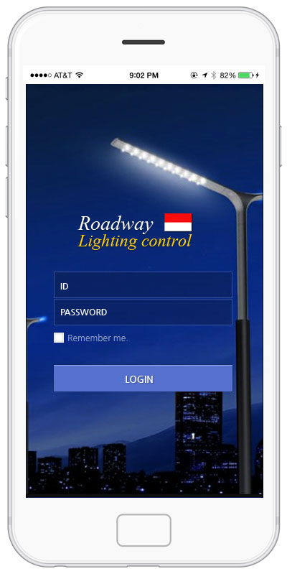
4. Screen shot
7) Mobile > Login
UpdateTemplate
Template
CatCat

Slide 19
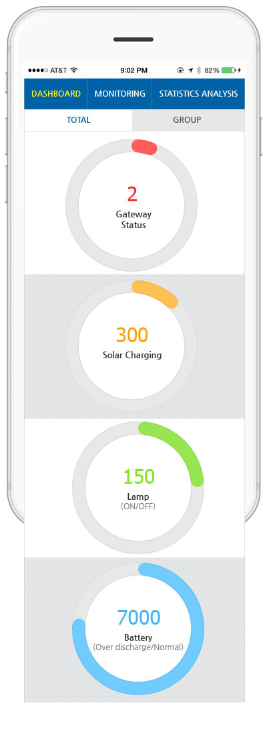
4. Screen shot
7) Mobile > Dashboard
UpdateTemplate
Template
CatCat

Slide 20
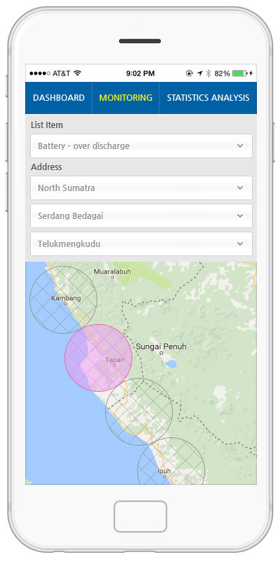
4. Screen shot
7) Mobile > Monitoring
UpdateTemplate
Template
CatCat

Slide 21
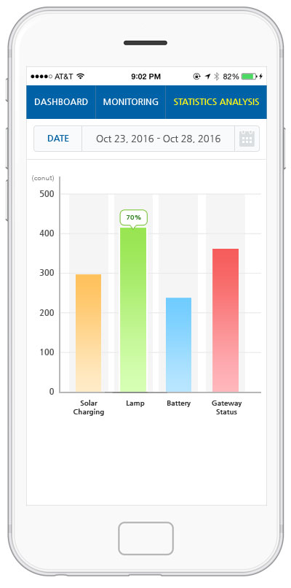
4. Screen shot
7) Mobile > Statistical Analysis
UpdateTemplate
Template
CatCat

